Slide 1
Weather Information Web Application
2025
NIKHIL JAISWAL

Slide 2
1. Introduction
2025
The Weather Information Web Application is a Flask-based project that allows users to check the current weather conditions for various cities in India. Users can enter a city name, and the app will display the temperature and weather description.

Slide 3
2. Objectives
2025
Develop a simple web application to provide weather updates.
Use Flask as the backend framework.
Implement a user-friendly interface with HTML templates.
Provide weather data for multiple cities.

Slide 4
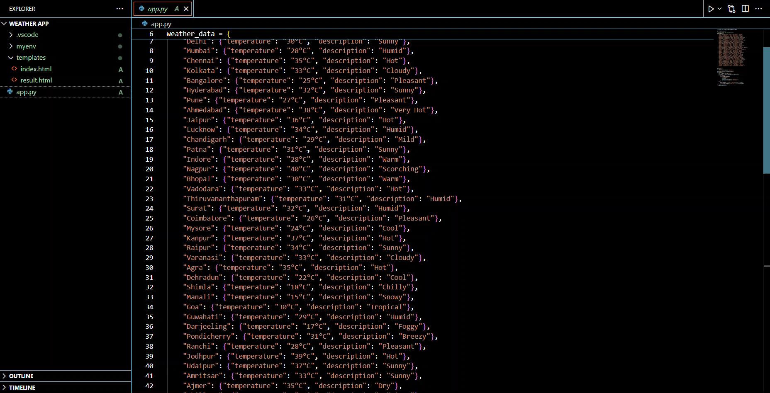
PICTURE SLIDE
2025

Slide 5
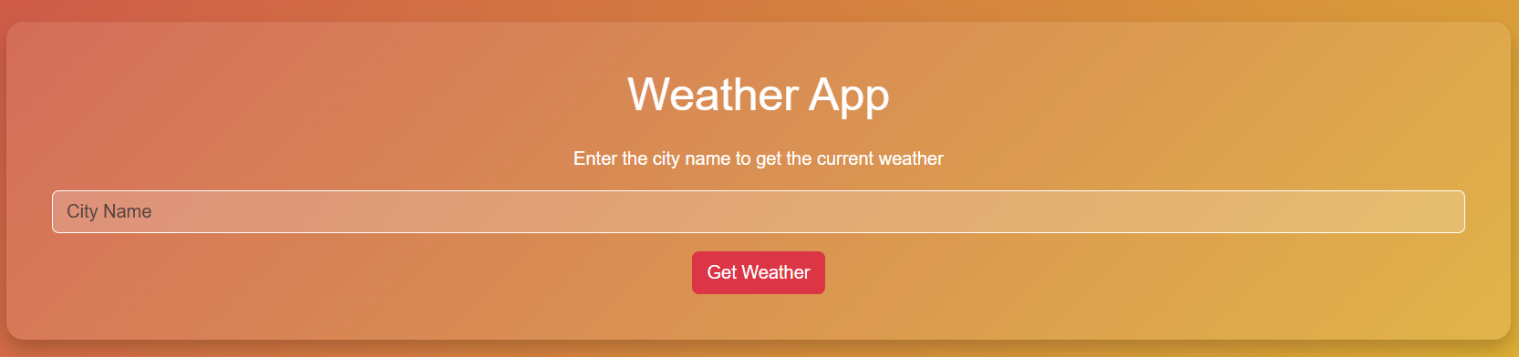
3. Technologies Used
2025
Backend: Python (Flask)
Frontend: HTML, CSS (for styling)
Server: Flask Development Server
Development Tools: VS Code, PyCharm
Version Control: GitHub (if applicable)

Slide 6
4. Project Structure
2025
5. Application Workflow
User accesses the homepage (/).
User enters a city name and submits the form.
The backend (/weather route) processes the input:
Checks if the city exists in the dataset.
If found, displays the temperature and weather condition.
If not found, shows an error message.
The result page (result.html) displays weather details.
/weather-app
│── app.py # Main Flask application
│── templates/
│ │── index.html # Home page with input form
│ │── result.html # Result page displaying weather data
│── static/
│ │── style.css # (Optional) Styles for UI
│── requirements.txt # Dependencies for Flask
│── README.md # Project documentation

Slide 7
5. Application Workflow
2025
User accesses the homepage (/).
User enters a city name and submits the form.
The backend (/weather route) processes the input:
Checks if the city exists in the dataset.
If found, displays the temperature and weather condition.
If not found, shows an error message.
The result page (result.html) displays weather details.

Slide 8
6. Code Overview
2025
Backend (app.py)
Routes:
/ → Renders the input form (index.html).
/weather → Processes user input and displays weather data.
Uses a predefined dictionary (weather_data) to store city weather information.
Implements error handling for unknown cities.
Frontend (HTML & CSS)
index.html: Contains a form where users enter a city name.
result.html: Displays weather information after submission.

Slide 9
7. Future Enhancements
Fetch real-time weather data using an API (OpenWeatherMap, WeatherAPI).
Store user search history in a database.
Improve UI with Bootstrap and animations.
Add voice search functionality.

Slide 10
THANK YOU!
2025
NIKHIL JAISWAL

